Slide 1
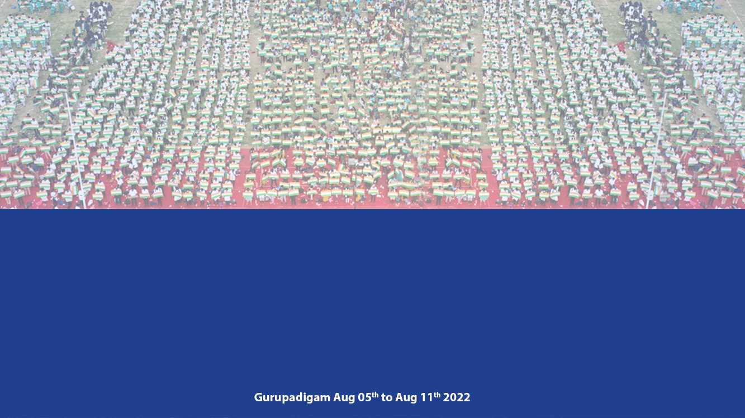
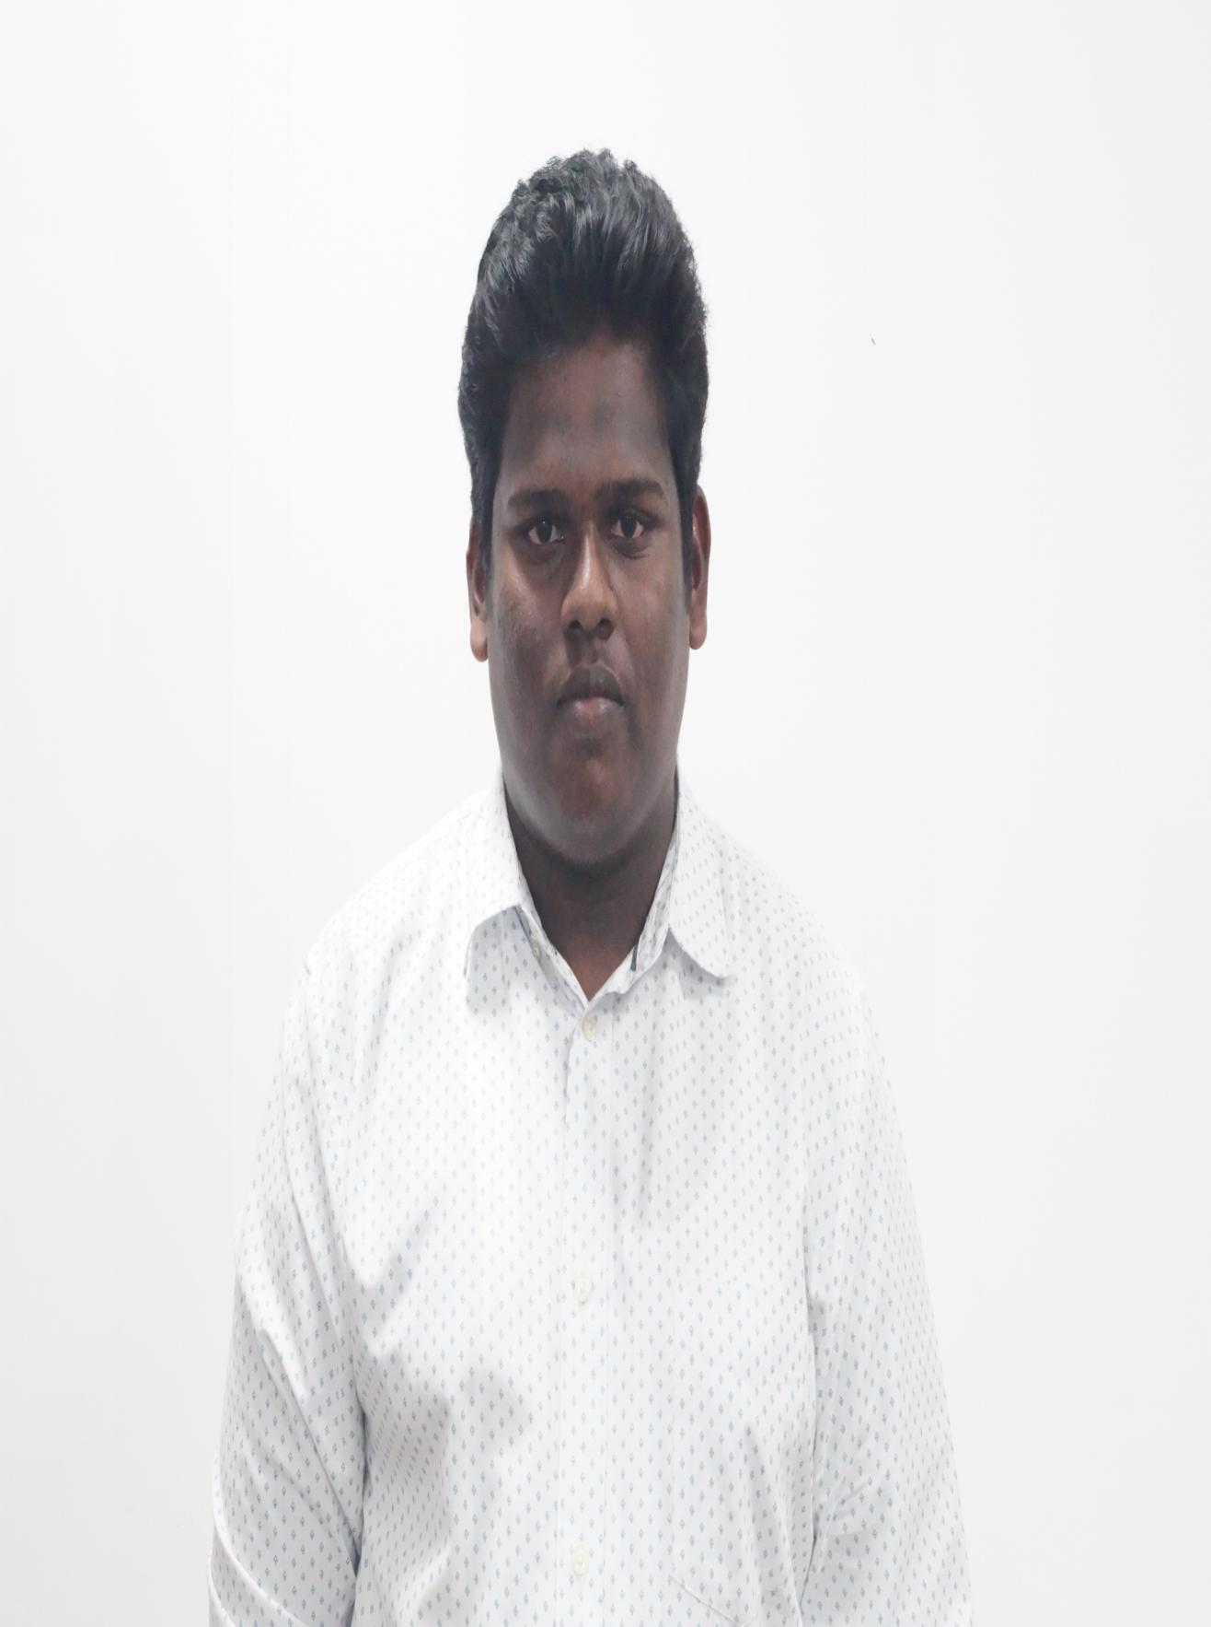
Name:BANDILA SUJITH
Register Number:192021012
III Year
Institute of Information Technology and Engineering

Slide 2
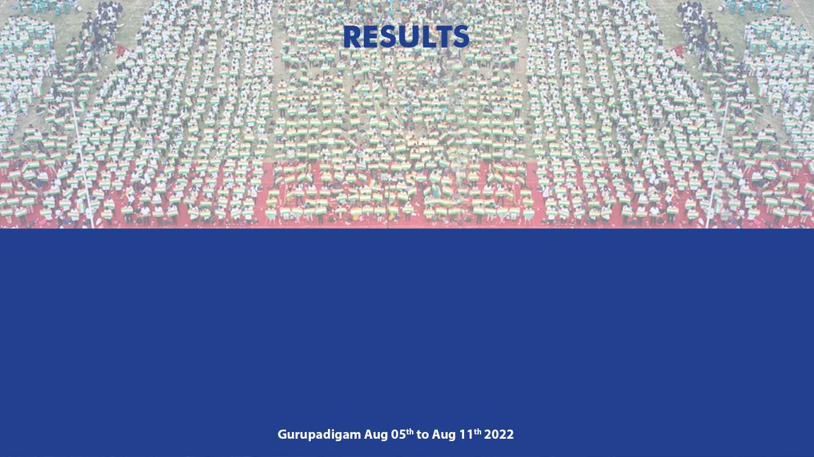
Slot A | Total Marks | Marks Obtained
Test 1 | 25 | 20
Test 2 | 25 | 15
Test 3 | 25 | 20

Slide 3
Dear parent
He has not attended mentor mentee meeting which was conducted on 12.08. 2022. He has to improve his marks and aim for S grade for slot C and D and he has not reported test marks to me. He must start attending seminars and webinars to improve his communication and technical skills. He must be regular to all slots lab sessions. Good that he has registered for NPTEL courses. Attendance is compulsory for mini project ( Product design and development)

Slide 4

SIR I WENT TO WRITE SUPPLEMENTARY EXAM ON 12.08.22. THAT WHY I DIDNT ATTENDED THE MENTEE CLASS ON FRIDAY
SLOW LEARNER IMPROVE HIM
MENTEE RESPONSE
PARENTS RESPONSE

